Slide 1
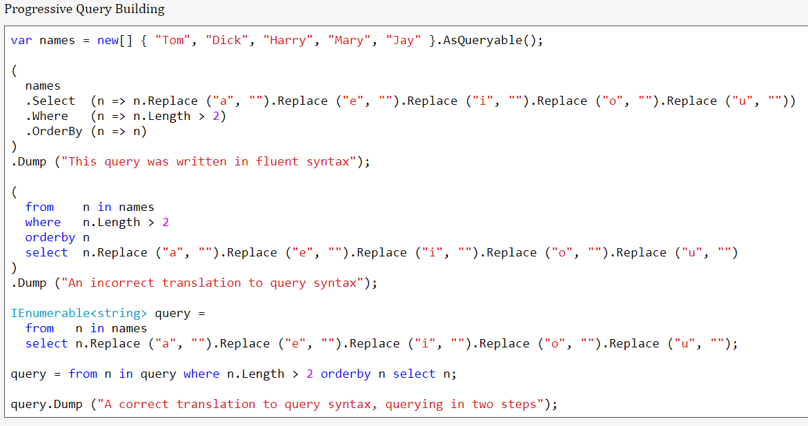
Composite Strategies

Slide 2
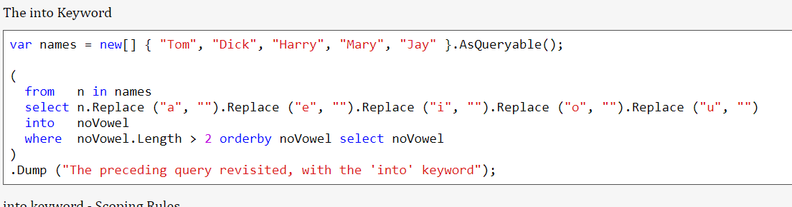
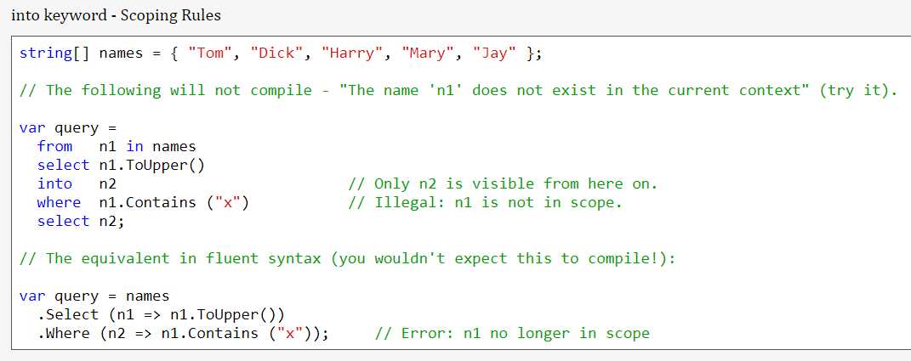
Composite Strategies

Slide 3
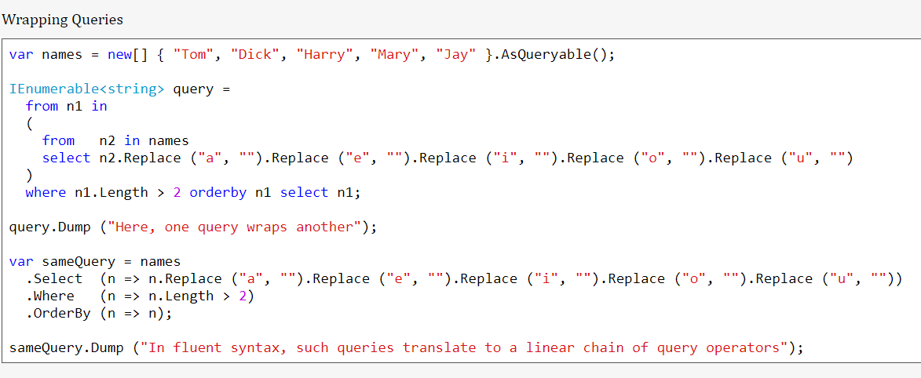
Composite Strategies

Slide 4
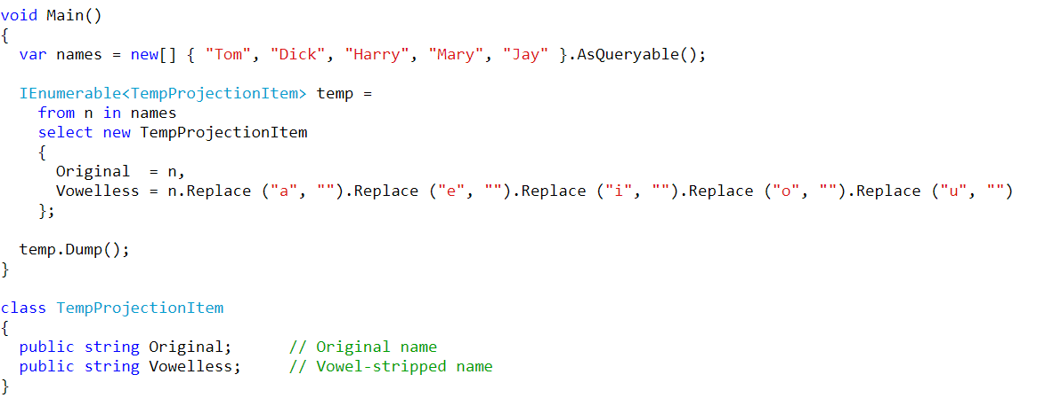
Projection Queries

Slide 5
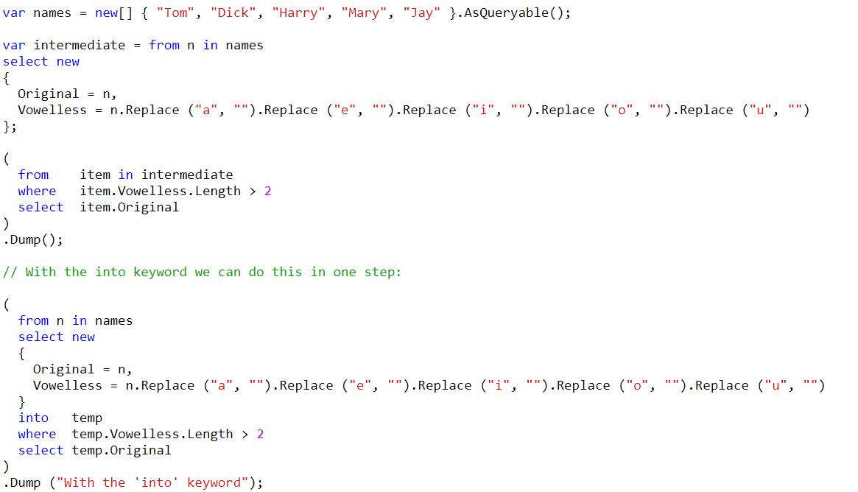
Projection Queries

Slide 6
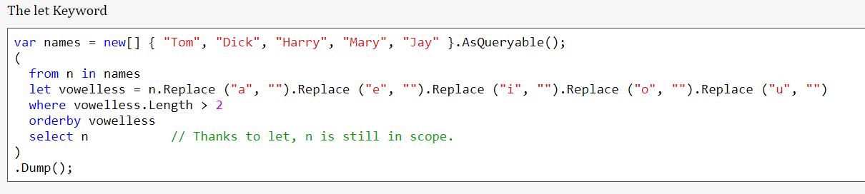
Projection Queries

Slide 7
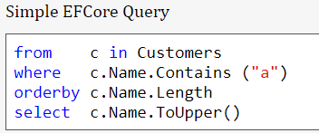
Interpreted Queries

Slide 8
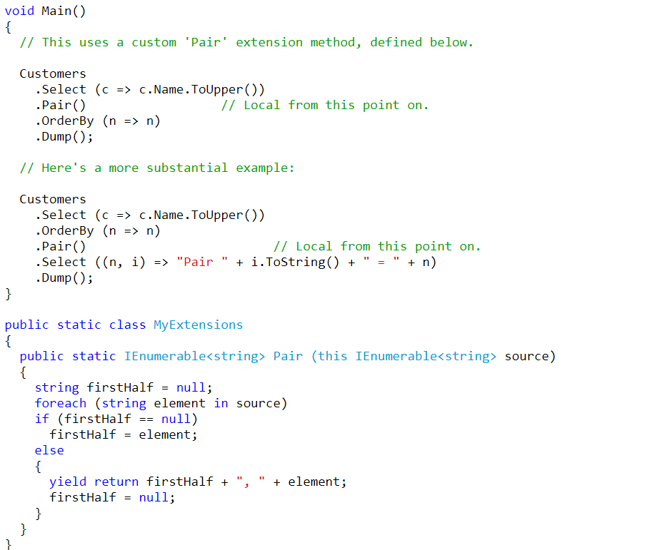
Interpreted Queries

Slide 9
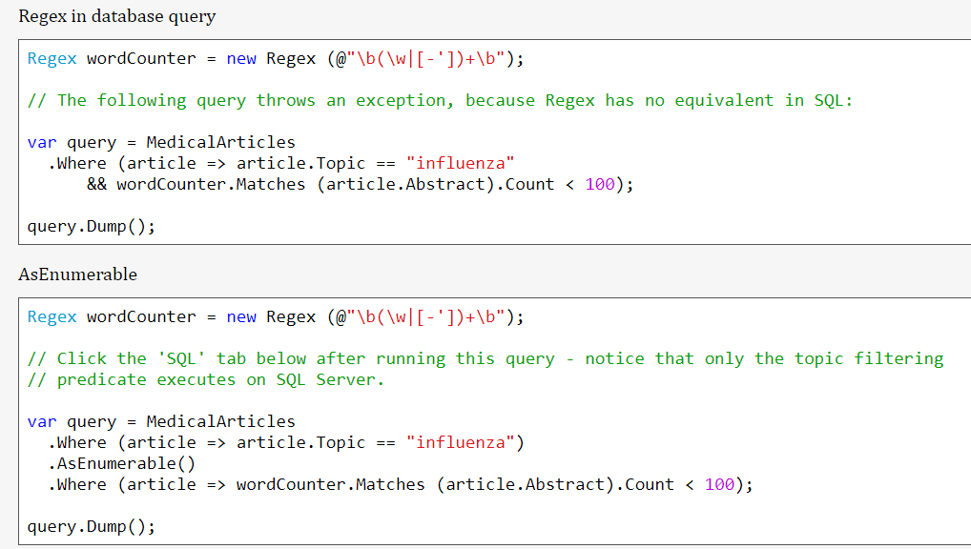
Interpreted Queries

Slide 10
Threading
Threads are the backbone of any software application.
In simple terms, a thread is a single sequence of instructions that a process can execute.
In C#, the System.Threading namespace offers classes that allow you to manipulate threads.
When a C# program starts, it’s a single threaded process by default.
This “main” thread is responsible for executing your code line by line, creating what is known as a single threaded application.
Threads make it possible to execute several program pieces concurrently, enhancing the program’s efficiency.
This brings us to the concept of multithreading.

Slide 11
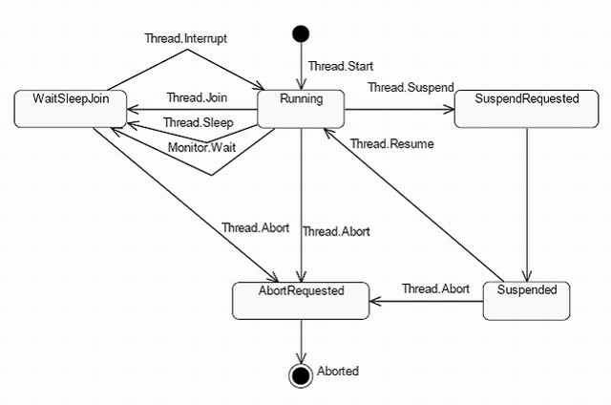
Thread Lifecycle

Slide 12
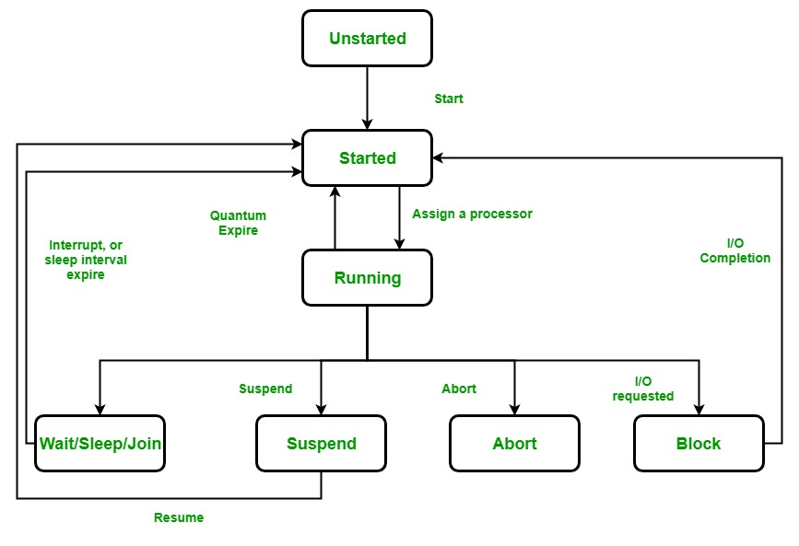
Thread Lifecycle

Slide 13
Types of Threads
Foreground Threads: These threads are created using the Thread class in C#.
They are the main threads of an application.
They prevent the application from terminating until all foreground threads have completed their tasks.
A foreground thread can be created by calling the Thread.Start() method.

Slide 14
Types of Threads
Background Threads: These threads are also created using the Thread class in C#, but they are the secondary threads of an application.
They do not prevent the application from terminating, even if they are still running.
A background thread can be created by calling the Thread.Start() method and then setting the IsBackground property of the thread to true before starting it.

Slide 15
Types of Threads
When an application starts, it automatically creates a foreground thread, which is the main thread of the application.
All the threads are background thread by default.
We can change the type of a thread by setting the IsBackground property of the thread.

Slide 16
Types of Threads
Foreground threads are useful when we need to perform a task that is critical to the operation of the application and must be completed before the application can terminate.
For example, a foreground thread might be used to update the user interface or to perform important calculations.

Slide 17
Types of Threads
Background threads are useful when you need to perform a task that is not critical to the operation of the application and can be terminated if the application needs to shut down.
For example, a background thread might be used to download a large file or to perform periodic updates to a database.

Slide 18
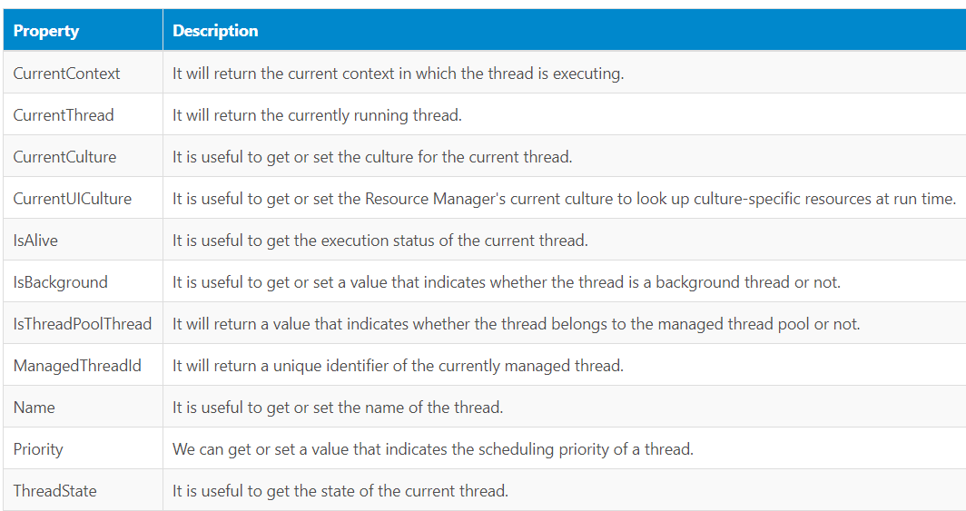
Thread Properties

Slide 19
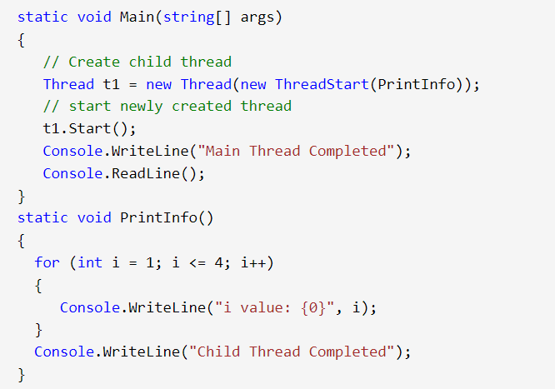
How to create Thread

Slide 20
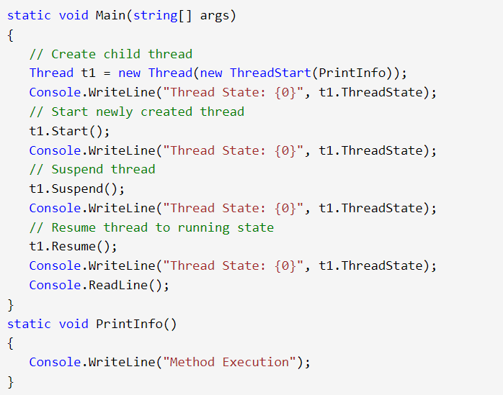
Thread Lifecycle

Slide 21
Multithreading
In c#, multithreading means executing multiple threads simultaneously to perform multiple tasks at a time.
The perfect example of multithreading is the operating system.
For example, in the windows operating system, we can open multiple applications like excel, word, notepad, browser, etc., to perform multiple tasks simultaneously.
In an operating system, each application process will be taken care by separate threads.

Slide 22
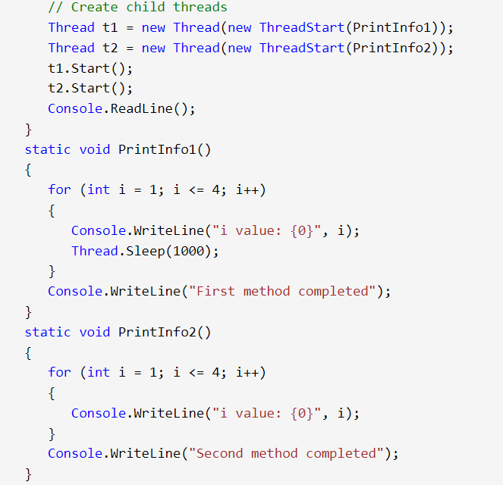
Multi Threading

Slide 23
Joining Threads in C#
In C#, we can create and run multiple threads simultaneously to perform different tasks concurrently.
Sometimes, it is necessary to wait for one thread to complete before starting another thread or wait for all threads to complete before proceeding further.
To achieve this, we can use the following methods to join threads in C#:
Thread.Join(): The Join method of the Thread class waits for the thread to complete its execution before continuing with the execution of the calling thread.
This method blocks the calling thread until the target thread has completed its execution.

Slide 24
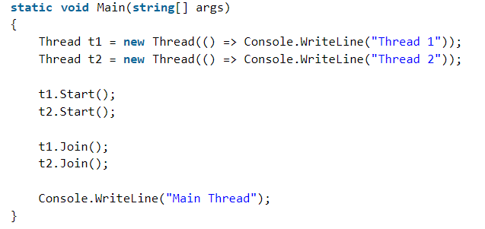
Joining Threads in C#

Slide 25
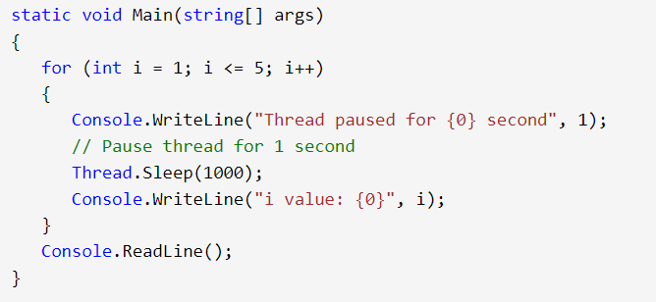
Sleep
In c#, the sleep method is useful to suspend or pause the current thread execution for a specified time.

Slide 26
Synchronization
Synchronization is the act of coordinating concurrent actions for a predictable outcome.
Synchronization is particularly important when multiple threads access the same data.

Slide 27
The synchronization constructs
Exclusive locking
Exclusive locking constructs allow just one thread to perform some activity or execute a section of code at a time.
Their primary purpose is to let threads access shared writing state without interfering with one another.
The exclusive locking constructs are lock, Mutex, and SpinLock.

Slide 28
The synchronization constructs
Nonexclusive locking
Nonexclusive locking lets us limit concurrency.
The nonexclusive locking constructs are Semaphore(Slim) and ReaderWriterLock(Slim)

Slide 29
The synchronization constructs
Signaling
These allow a thread to block until receiving one or more notifications from other thread(s).
The signaling constructs include Manual Reset Event(Slim),AutoResetEvent, CountdownEvent, and Barrier.
The former three are referred to as event wait handles.

Slide 30
Thread Safety and .NET Types
We can use locking to convert thread-unsafe code into thread-safe code.
A good application of this is .NET: nearly all its nonprimitive types are not thread-safe (for anything more than read-only access) when instantiated.
We can use them in multithreaded code if all access to any given object is protected via a lock.

Slide 31
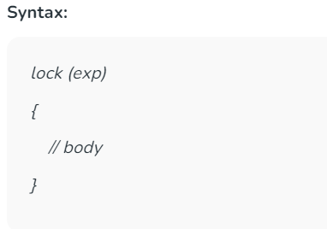
Blocking (Exclusive Lock in Thread)
The lock statement is used to take the mutual-exclusion lock for a specified object.
It executes a specified block and then releases the lock.
The time during which the lock is active, the thread that holds the lock can again take and release the lock.
Note that any other thread cannot access the lock and it waits unless the lock is released.

Slide 32
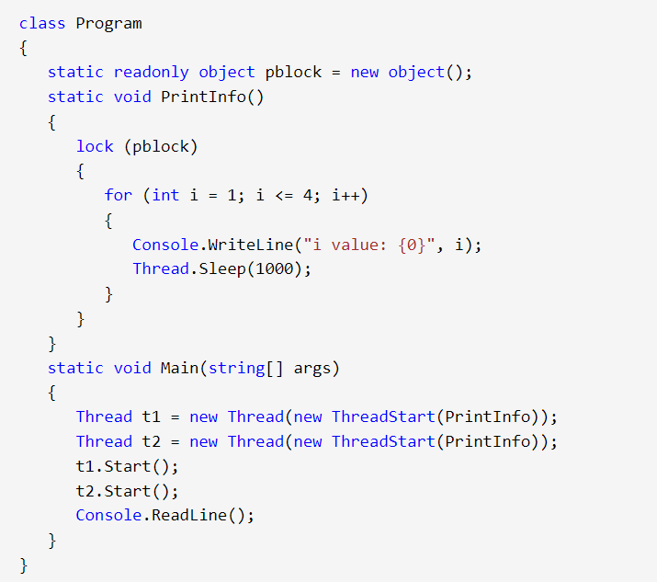
Blocking (Lock in Thread)

Slide 33
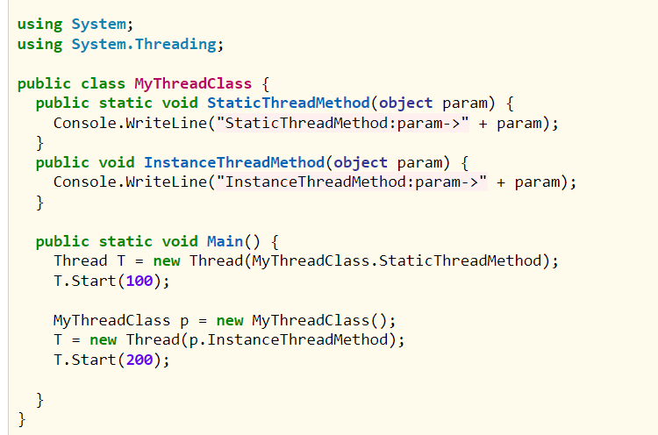
Pass Parameter to Thread

Slide 34
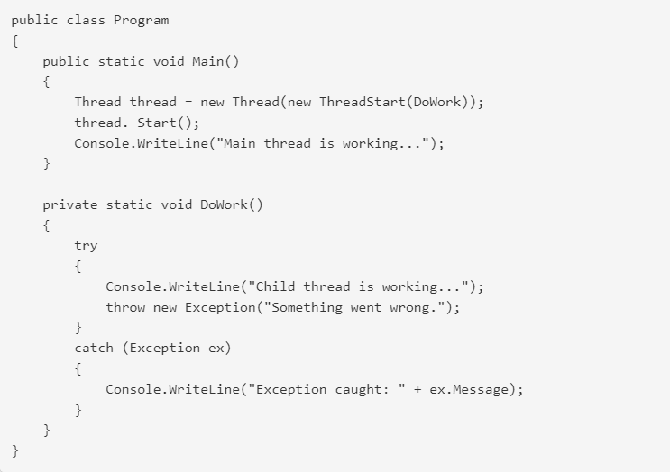
Thread Exception Handling

Slide 35
Thread Priority
In a Multithreading environment, each thread has their own priority.
A thread’s priority shows how frequently a thread gains the access to CPU resources.
Whenever we create a thread in C#, it always has some priority assigned to it.

Slide 36
Thread Priority
A programmer can explicitly assign priority to a thread.
The by default priority of a thread is Normal.
Operating system does not assign the priority of threads.
If a thread has reached a final state, such as Aborted, then this will give ThreadStateException.
If the value specified for a set operation is not a valid ThreadPriority value, then this will give ArgumentException
It is not guaranteed that the thread whose priority is high will executes first and the thread whose priority is low will executes after.
Due to context switching the highest priority thread may execute after lowest priority thread.
When you are assigning a priority to a thread you need to be careful, if you are not doing carefully you may get thread starvation.
The thread priority will always depend upon the process priority or parent container, so by setting the thread priority to highest will not correspond to real-time execution.

Slide 37
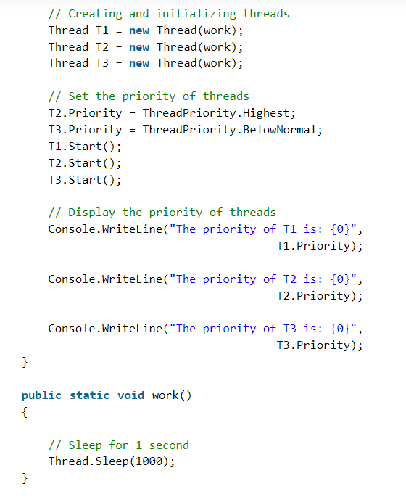
Thread Priority

Slide 38
Local Versus Shared State
The CLR assigns each thread its own memory stack.
So that local variables are kept separate.
We define a method with a local variable.
Then call the method simultaneously on the main thread and a newly created thread:

Slide 39
Local State (Thread-Local Storage)
A local state is a variable or data that is confined to a single thread, meaning no other thread can access or modify it.
This approach eliminates the need for synchronization mechanisms since there’s no shared resource.

Slide 40
Local State (Thread-Local Storage)
Examples of Local State
Local variables inside a method: Each thread gets its own stack, so method variables are inherently thread-safe.
Thread-local storage (TLS): Data that is unique to a particular thread.

Slide 41
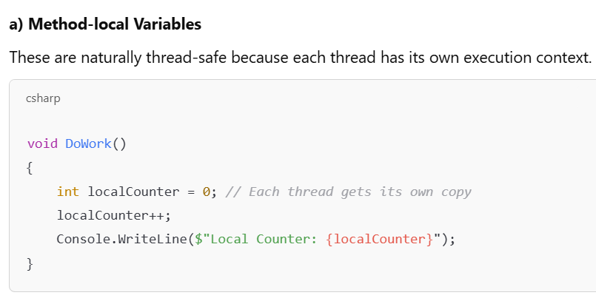
Local State (Thread-Local Storage)

Slide 42
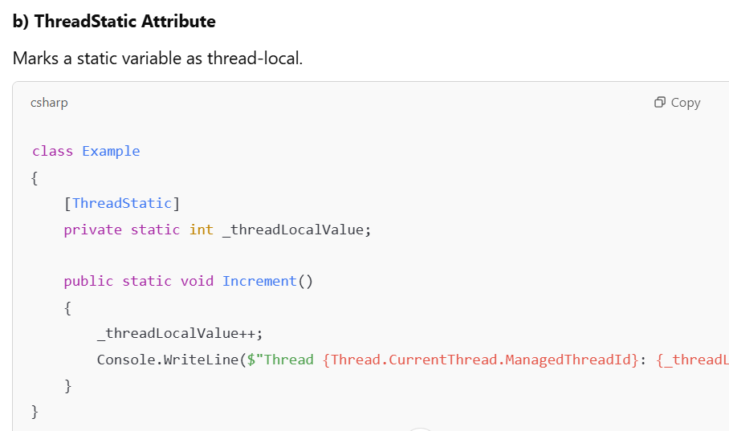
Local State (Thread-Local Storage)

Slide 43
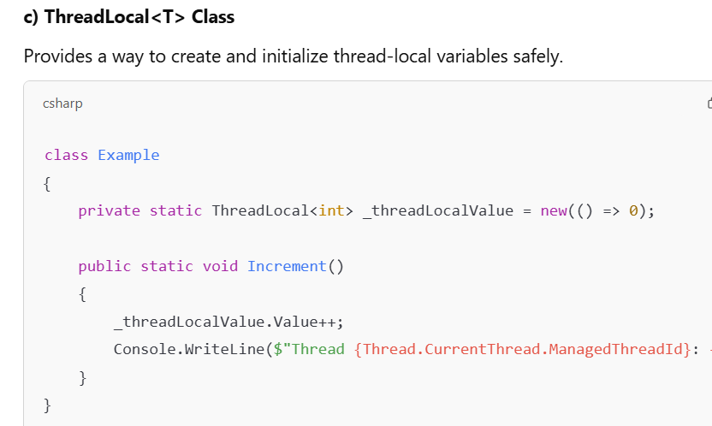
Local State (Thread-Local Storage)

Slide 44
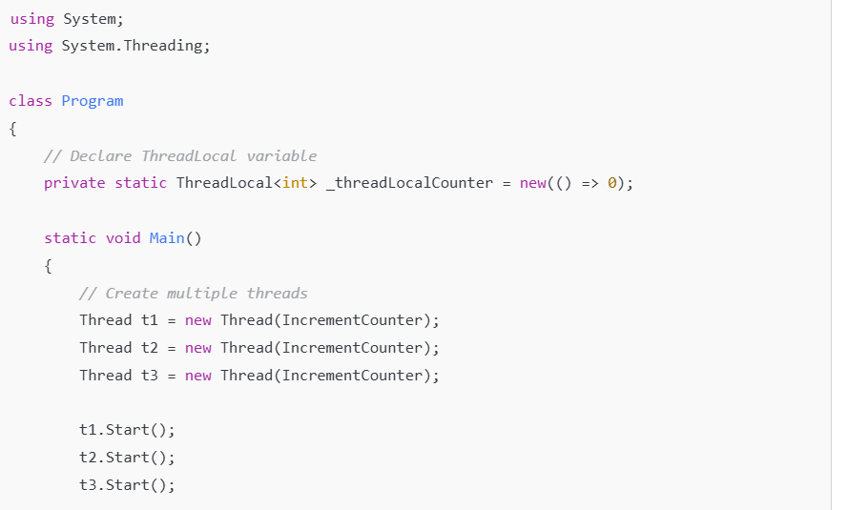
Local State (Thread-Local Storage)

Slide 45
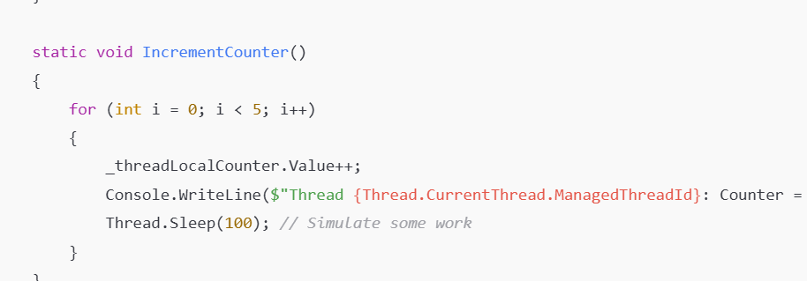
Local State (Thread-Local Storage)

Slide 46
Shared State (Shared Resources)
A shared state is data accessible by multiple threads.
This requires synchronization to prevent race conditions, deadlocks, and data corruption.
Challenges with Shared State Race conditions:
Multiple threads modifying the same variable concurrently.
Deadlocks: Circular waits due to improper locking.
Performance issues: Excessive locking can reduce concurrency.

Slide 47
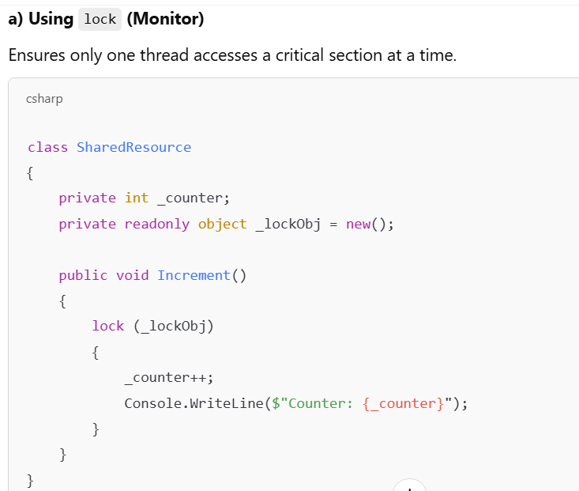
Shared State (Shared Resources)

Slide 48
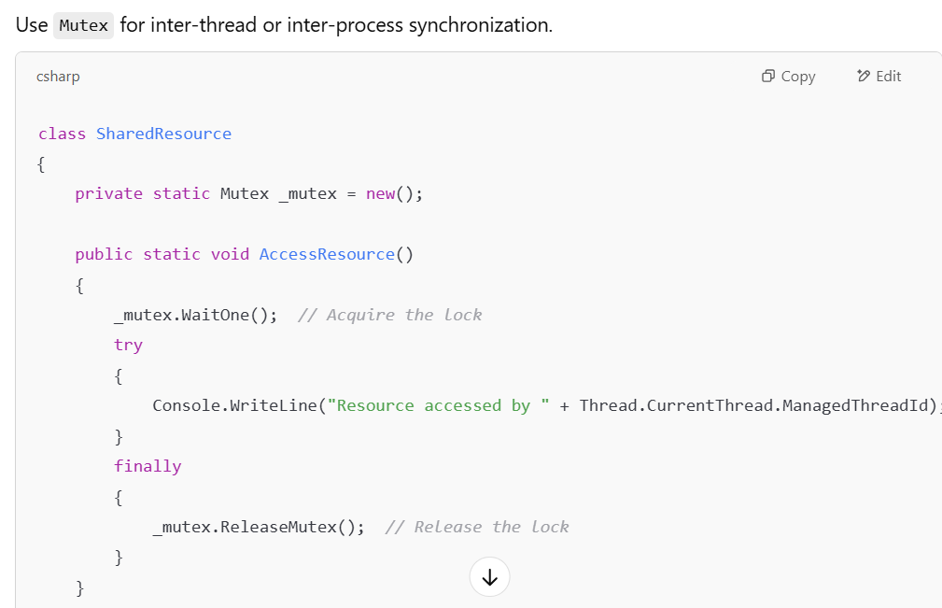
Shared State (Shared Resources)

Slide 49
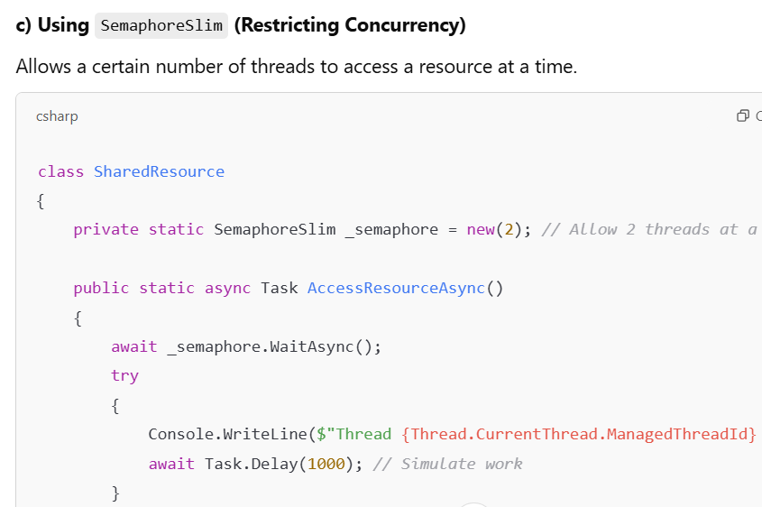
Shared State (Shared Resources)

Slide 50
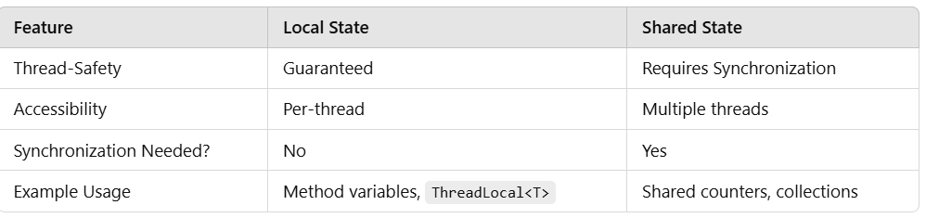
Local Versus Shared State

Slide 51
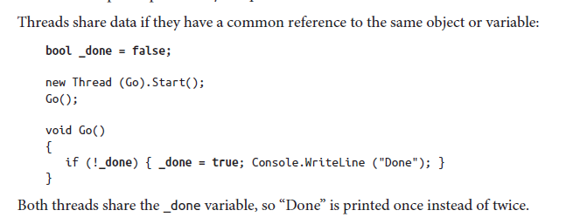
Local Versus Shared State

Slide 52
Thread Signaling
Thread signaling is a mechanism where one thread notifies another thread to start, stop, or continue execution.
This is essential in multithreaded applications to coordinate work between threads.

Slide 53
Why Use Thread Signaling?
Prevents busy waiting (looping until a condition is met).
Ensures thread synchronization in concurrent scenarios.
Useful for producer-consumer and sequential execution patterns.

Slide 54
. Thread Signaling Mechanisms in C#
C# provides various signaling mechanisms, including:
Manual Reset Event & Auto Reset Event – Simple event-based signaling.
Count down Event – Signals when multiple threads have completed.
Barrier – Synchronizes multiple threads at a checkpoint.
Semaphore Slim – Controls thread access to resources.Monitor.
Pulse/Pulse All – Wakes up waiting threads inside a lock.

Slide 55
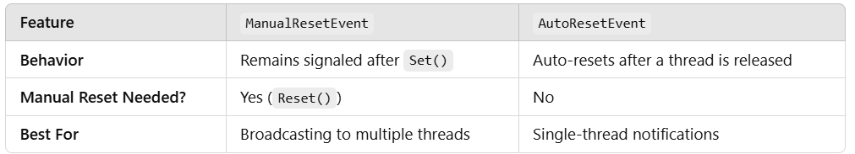
. Manual Reset Event & AutoReset Event

Slide 56
Barrier
The Barrier class implements a thread execution barrier, allowing many threads to rendezvous at a point in time.
The class is very fast and efficient, and is built upon Wait, Pulse, and spinlocks.
To use this class:
1. Instantiate it, specifying how many threads should partake in the rendezvous.
2. Have each thread call SignalAndWait when it wants to rendezvous.
Instantiating Barrier with a value of 3 causes SignalAndWait to block until that method has been called three times.
It then starts over: calling SignalAndWait again blocks until called another three times.
This keeps each thread “in step” with every other thread.

Slide 57
Barrier

Slide 58
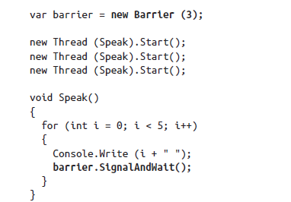
Barrier

Slide 59
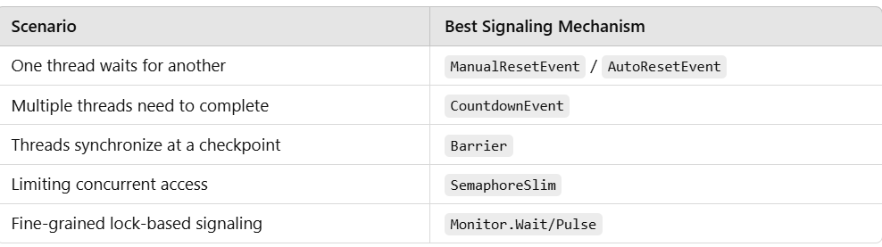
Choosing the Right Signaling Mechanism

Slide 60
Threading in Rich Client Applications
Rich client applications, such as WPF (Windows Presentation Foundation) and WinForms (Windows Forms), require careful threading to maintain UI responsiveness while performing background operations.

Slide 61
Threading in Rich Client Applications
The UI Thread is single-threaded – Running time-consuming tasks on the UI thread freezes the UI.
Need for Background Processing – Heavy computations, network requests, and database operations should run in background threads to keep the UI responsive.
Thread Synchronization is Required – UI elements can only be updated from the UI thread (invoking updates from worker threads requires synchronization).

Slide 62
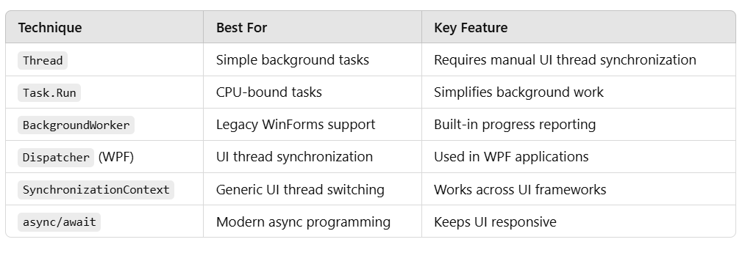
Threading in Rich Client Applications

Slide 63
Synchronization Contexts
It allows switching back to the UI thread from a background thread.
It ensures thread synchronization without explicitly using Invoke() (WinForms) or Dispatcher (WPF).
It's especially useful in UI applications (WinForms/WPF) to avoid cross-thread exceptions.

Slide 64
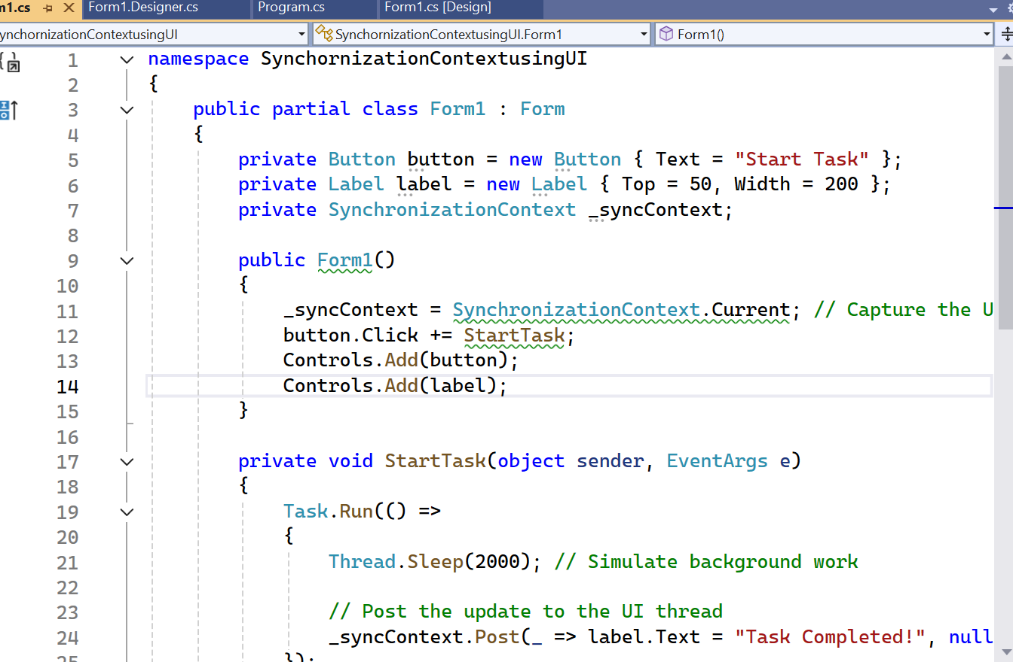
Synchronization Contexts

Slide 65
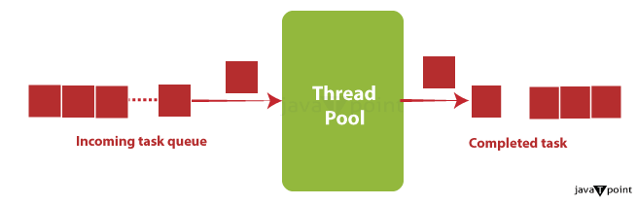
Thread Pool
The Thread Pool in C# is a managed pool of worker threads that efficiently handles background tasks, reducing the overhead of creating and destroying threads manually.

Slide 66
Why Use the Thread Pool?
✅ Automatic thread management – No need to create/destroy threads manually. ✅ Efficient resource utilization – Uses a pool of pre-created threads. ✅ Prevents excessive thread creation – Limits the number of concurrent threads. ✅ Ideal for short-lived tasks – Great for I/O-bound and CPU-bound operations.

Slide 67
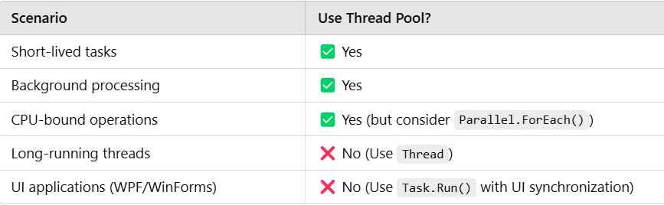
When to Use the Thread Pool

Slide 68
Thread Pool
We cannot set the Name of a pooled thread, making debugging more difficult.
Pooled threads are always background threads.

Slide 69
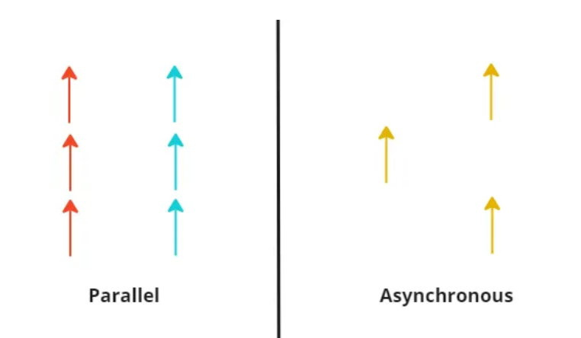
Parallel vs Asynchronous
Parallel execution means that you have multiple threads doing different job and not knowing about each other.
Asynchronous execution refers to having single thread switching between different jobs.

Slide 70
Task
Task in C# represents an asynchronous operation that runs on the Thread Pool.
It is a higher-level abstraction over threads and is the preferred way to perform concurrent and asynchronous programming.

Slide 71
Why Use Task Instead of Thread?
✅ Automatic thread management – Uses the Thread Pool instead of creating new threads manually.
✅ Built-in async support – Works seamlessly with async/await.
✅ Supports cancellation & continuations – Can be canceled or chained easily.
✅ Efficient for short-lived operations – Unlike Thread, Task is optimized for background tasks.

Slide 72
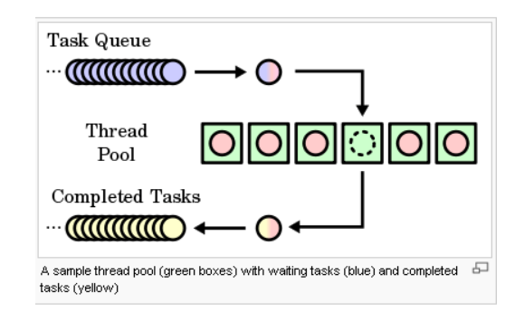
Task

Slide 73
Creating and Running Tasks
Tasks can be created using:
Task.Run()
Task.Factory.StartNew()
new Task().Start()

Slide 74
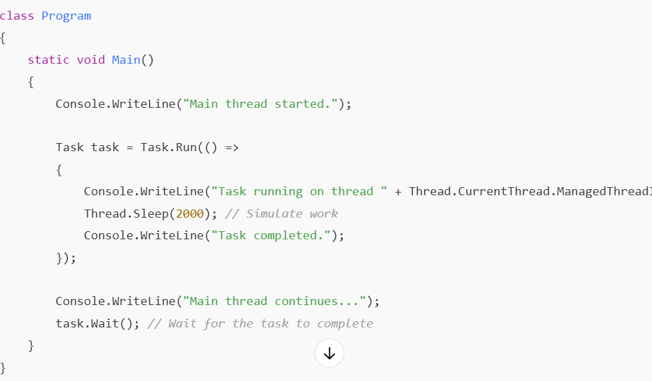
Creating and Running Tasks

Slide 75
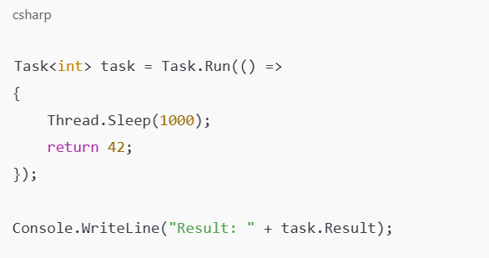
Returning Values From Task

Slide 76
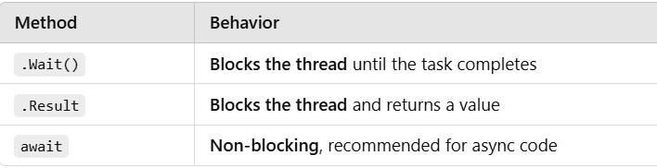
Waiting for a Task (Wait vs. await)

Slide 77
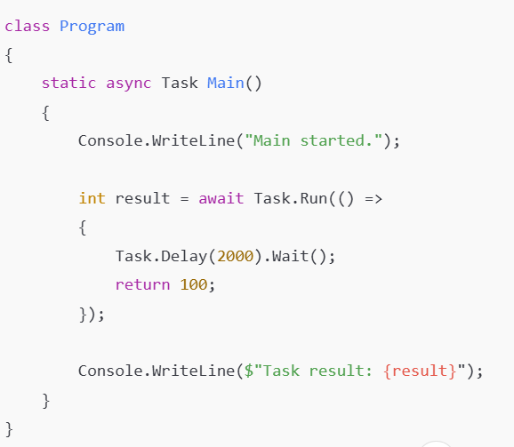
Waiting for a Task (Wait vs. await)

Slide 78
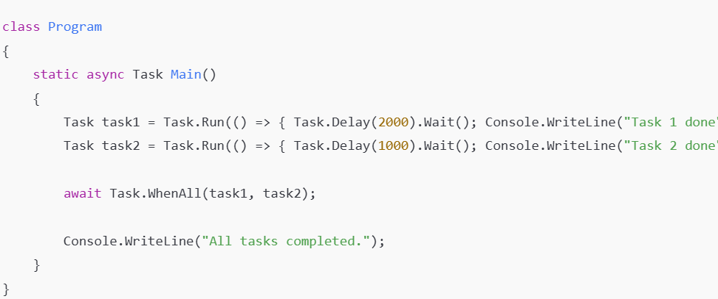
Running Multiple Tasks in Parallel

Slide 79
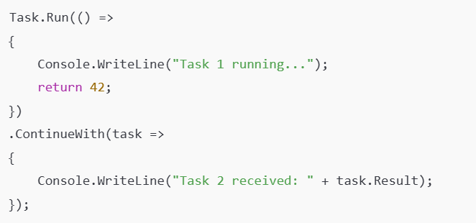
Task Continuations (ContinueWith)

Slide 80
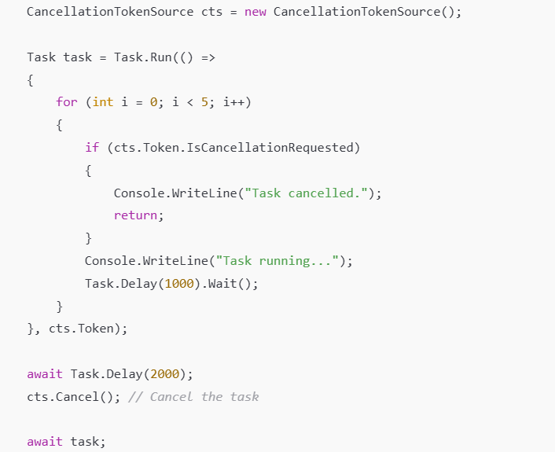
Task Cancellation (CancellationToken)

Slide 81
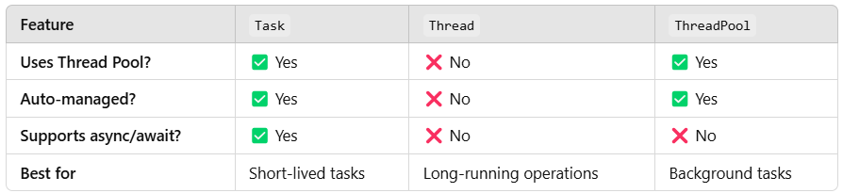
Task vs Thread vs Thread Pool

Slide 82
Differences Between Task And Thread
The Thread class is used for creating and manipulating a thread in Windows.
A Task represents some asynchronous operation and is part of the Task Parallel Library, a set of APIs for running tasks asynchronously and in parallel.
The task can return a result.
There is no direct mechanism to return the result from a thread.
Task supports cancellation using cancellation tokens. But Thread doesn't.
A task can have multiple processes happening at the same time.
Threads can only have one task running at a time.

Slide 83
Differences Between Task And Thread
We can easily implement Asynchronous using ’async’ and ‘await’ keywords.
A new Thread() is not dealing with Thread pool thread, whereas Task does use thread pool thread.
A Task is a higher level concept than Thread.

Slide 84

Entering Thread Pool
The easiest way to explicitly run something on a pooled thread is to use Task.Run
// Task is in System.Threading.Tasks
Task.Run (() => Console.WriteLine ("Hello from the thread pool"));

Slide 85
Task
The easiest way to start a Task backed by a thread is with the static method Task.Run.
Simply pass in an Action delegate:
Task.Run (() => Console.WriteLine (“Rocking…"));

Slide 86
Task
Calling Task.Run in this manner is same as starting a thread as follows
new Thread (() => Console.WriteLine (“Rock")).Start();
Task.Run returns a Task object that we can use to monitor its progress, rather like a Thread object.

Slide 87

Wait

Slide 88

Returning values
Task has a generic subclass called Task<TResult>, which allows a task to emit a return value.
We can obtain a Task<TResult> by calling Task.Run with a Func <TResult> delegate instead of an Action:
Task<int> task = Task.Run (() => { Console.WriteLine (“Rock"); return 3; }
int result = task.Result; // Blocks if not already finished
Console.WriteLine (result); //

Slide 89

Exceptions

Slide 90

Creating a continuation for a single antecedent

Slide 91

Scheduling Different Continuation Tasks

Slide 92

Parallel Programming
Nowadays, multicore processors (2 cores, 4 cores, 8 cores …) become very popular.
Even they can be found in most devices.

Slide 93

Parallel Programming

Slide 94

Parallel Programming

Slide 95

Parallel Programming

Slide 96

Parallel Programming

Slide 97

Parallel Programming

Slide 98

Parallel Programming

Slide 99


PLINQ

Slide 100

PLINQ

Slide 101

PLINQ AS Ordered

Slide 102

PLINQ AS Ordered

Slide 103

PLINQ AS Ordered

Slide 104

Parallel Invoke

Slide 105

Parallel Cancellation

Slide 106

Parallel Cancellation

Slide 107

Parallel Cancellation

Slide 108
Common Pitfalls and Best Practices
Overuse of Generics
Using generics for every scenario may lead to code that is overly complex and hard to understand.
It’s essential to strike a balance and use generics where they genuinely add value.
Avoid Tight Coupling
Avoid creating overly complex generic classes that are tightly coupled with various types.
Tight coupling can make your code less maintainable and harder to test.

Slide 109
Common Pitfalls and Best Practices
Provide Clear Documentation
When creating generic classes or methods, document their usage and constraints clearly.
Good documentation helps other developers understand how to use your generics effectively.
Test with Multiple Types
When designing generic classes or methods, thoroughly test them with various data types to ensure they work correctly and safely under different scenarios.

Slide 110
Common Pitfalls and Best Practices
Consider Code Duplication
Generics can be an excellent way to reduce code duplication,
But be cautious not to overcomplicate your codebase. Sometimes, it might be better to have separate non-generic implementations for specific cases.

Slide 111
File Handling
• File Handling in C#
• FileStream Class in C#
• StreamReader and StreamWriter in C#
• File Class in C#
• TextWriter and TextReader in C#
• BinaryWriter and BinaryReader in C#
• StringWriter and StringReader in C#
• FileInfo Class in C#
• DirectoryInfo Class in C#
• Export and Import Excel Data in C#

Slide 112
File Handling
Generally, we use the file to store data.
The term File Handling in C# refers to the various operations that we can perform on a file such as creating a file, reading data from the file, writing data into the file, appending the file, etc.
Generally, we mostly perform three basic operations on a file: reading data from a file, writing data to a file and appending data to a file.
Reading: This operation is the basic read operation where the data is going to be read from a file.
Writing: This operation is the basic write operation where the data is going to be written to a file.

Slide 113
File Handling
By default, all existing contents are removed from the file, and new content is written in the file.
Appending: This operation is the same as the write operation where the data is going to be written to a file.
The only difference between Write and Append is that the existing data in the file will not be overwritten.
With Append, the new data is going to be added at the end of the file.

Slide 114
Stream
When we open a file for reading or writing, it becomes stream.
Stream is a sequence of bytes traveling from a source to a destination over a communication path.
The two basic streams are input and output streams. Input stream is used to read and output stream is used to write.
The System.IO namespace includes various classes for file handling.
The parent class of file processing is stream.
Stream is an abstract class, which is used as the parent of the classes that implement the necessary operations.
The primary support of a file as an object is provided by a .NET Framework class called File.
This static class is equipped with various types of (static) methods to create, save, open, copy, move, delete, or check the existence of a file.

Slide 115

System.IO Namespace in C#

Slide 116

Directory Search
DirectoryInfo dir

Slide 117

Overview of Classes

Slide 118
What is File Stream Class in C#?
The File Stream Class in C# provides a stream for file operations.
It can be used to perform both Synchronous and Asynchronous Read and Write operations.
With the help of File Stream Class, we can easily read and write data into files.
To use File Stream Class in C#, first of all, we need to include the System.IO namespace.
Then we need to create an instance of the File Stream class either to create a new file or to open an existing file.
If we go to the definition of File Stream class, then we will see that there are many overloaded versions of Constructors available.

Slide 119

What is File Stream Class in C#?

Slide 120

What is File Stream Class using File?

Slide 121

What is File Stream Class using File?

Slide 122

What is File Stream Class using File?

Slide 123

What is File Stream Class in C#?

Slide 124

What is File Stream Write in C#?

Slide 125

What is File Stream Read in C#?

Slide 126

StreamReader and StreamWriter in C#

Slide 127

StreamReader and StreamWriter in C#

Slide 128
Text Writer and Text Reader
Text Writer is an abstract class belonging to the System.IO namespace.
It is used to write a sequential series of characters into a file.
It is the base class of Stream Writer and String Writer which is used to write characters to streams and strings respectively.
By default, it is not thread-safe.
As it is an abstract class, its object cannot be created. Any class implementing Text Writer must minimally implement its Write(Char) method to create its useful instance.

Slide 129

Text Writer and Text Reader

Slide 130

Text Writer and Text Reader

Slide 131

Text Writer and Text Reader

Slide 132
Binary Writer and Binary Reader in C#
The Binary Writer class in C# is used to write Primitive type data types such as int, uint, or char in the form of binary data to a stream.
It is present under the System.IO namespace.
As its name says Binary Writer writes binary files that use a specific data layout for its bytes.
The Binary Writer in C# creates a binary file that is not human-understandable, but the machine can understand it.
It supports writing strings in a specific encoding.
In order to create an object of Binary Writer, we need to pass an object of Stream to the constructor of the Binary Writer class.
The Binary Writer class in C# provides methods that simplify writing primitive data types to a stream.
If you don’t provide types of encoding while creating objects, then default encoding UTF-8 will be used.

Slide 133
Binary Writer and Binary Reader in C#
The Binary Writer class in C# is used to write Primitive type data types such as int, uint, or char in the form of binary data to a stream.
It is present under the System.IO namespace.
As its name says Binary Writer writes binary files that use a specific data layout for its bytes.
The Binary Writer in C# creates a binary file that is not human-understandable, but the machine can understand it.
It supports writing strings in a specific encoding.
In order to create an object of Binary Writer, we need to pass an object of Stream to the constructor of the Binary Writer class.
The Binary Writer class in C# provides methods that simplify writing primitive data types to a stream.
If you don’t provide types of encoding while creating objects, then default encoding UTF-8 will be used.

Slide 134

Binary Writer and Binary Reader in C#

Slide 135

Binary Writer and Binary Reader in C#

Slide 136
String Writer and String Reader in C#
The String Writer Class in C# is derived from the TextWriter class.
This String Writer class is mainly used to manipulate strings rather than files.
The String Writer class enables us to write a string either synchronously or asynchronously.
So, we can write a character either with Write(Char) or Write Async(Char) method.
We can write a string with Write(String) or Writer Async(String) method.

Slide 137
String Writer and String Reader in C#
The text or information written by String Writer class is stored inside a StringBuilder.
The Text namespace and the strings can be built efficiently using the StringBuilder class because strings are immutable in C# .
Write and WriteLine methods provided by String Writer help us to write into the object of StringBuilder.
StringBuilder class stores the information written by String Writer class.

Slide 138

String Writer and String Reader in C#

Slide 139
Export and Import Excel Data in C#
NPOI is an Open-Source library that can help us perform read and write operations on XLS, DOC, and PPT file extensions.
This NPOI Library is the .NET version of the POI Java project at http://poi.apache.org/.
This NPOI Library covers almost all the important features of Excel, like styling, formatting, data formulas, extracting images, etc.
And the most important thing is that it does not require Microsoft Office to be installed on the server.

Slide 140

Export and Import Excel Data in C#

Slide 141

Export and Import Excel Data in C#

Slide 142

Export and Import Excel Data in C#

Slide 143
Questions

Slide 144
Module Summary
Microservices using docker and Kubernets.
Message, Channel and Adapter
Understood the different Component Integration
Understood the Event-Driven Architecture

